Slide 1
Classification, Regression and Clustering

Slide 2
Introduction
When a machine learning task is presented, the first thing is to know whether the learning task is Classification or regression or clustering problem so that next you can pick the algorithm.
These are simple concepts to understand.
Regression and classification are supervised learning approach that maps an input to an output
Clustering is a unsupervised learning approach.

Slide 3
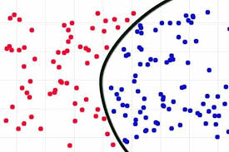
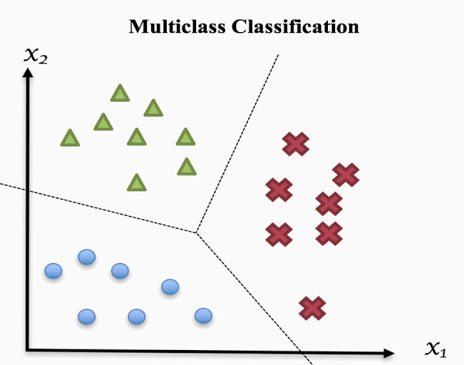
Classification
Predicts discrete number of values.
Binary classification — when there is only two classes to predict, usually 1 or 0 values.
Multi-Class Classification — When there are more than two class labels to predict

Slide 4
Algorithms for classification
Decision Trees
Logistic Regression
Naive Bayes
K Nearest Neighbors
Neural networks

Slide 5
Application of Classification Algorithms
Email spam classification
Bank customers loan pay bank willingness prediction.
Cancer tumor cells identification.
Sentiment analysis.
Drugs classification
Facial key points detection
Pedestrians detection in an automotive car driving.

Slide 6
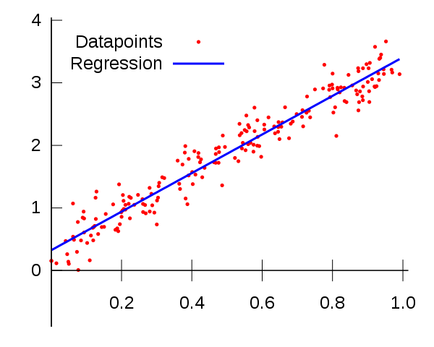
Regression Problems
In regression problems we trying to predict continuous valued output.
Example: Given a size of the house predict the price(real value).
Example: Predicting a person’s income from their age, education

Slide 7
Algorithms for regression
Simple Linear Regression model
Multivariate Regression algorithm
Decision Trees
Random forest

Slide 8
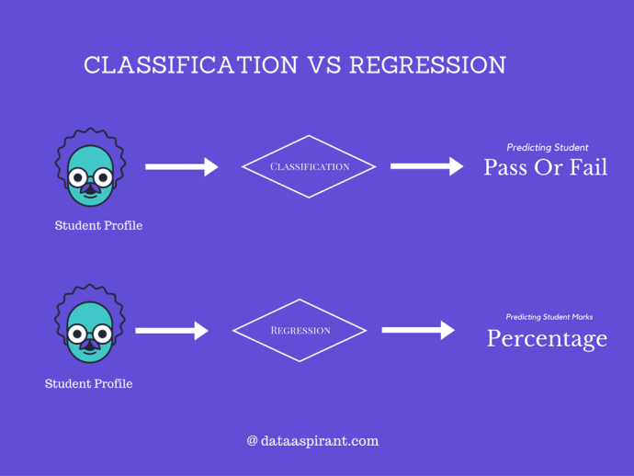
Classification vs Regression

Slide 9
Clustering
Clustering is the task of partitioning the dataset into groups, called clusters.
The goal is to split up the data in such a way that points within each cluster are very similar.
It determines grouping among unlabeled data.
Its grouping a set of new data based on similarities amongst them.
Given a set of data points, we can use a clustering algorithm to classify each data point into a specific group.

Slide 10
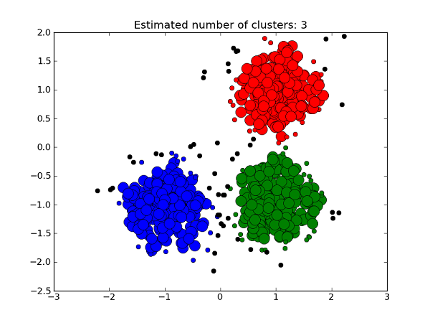
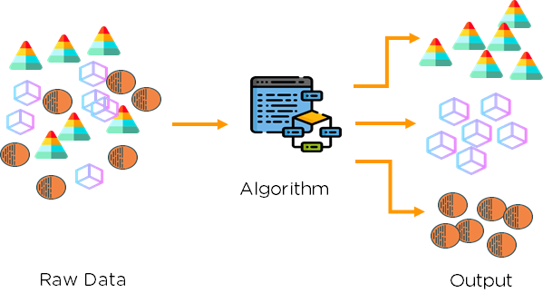
Algorithms for Clustering
K-Means Clustering
Hierarchical clustering

Slide 11
Application of Clustering Algorithms
Recommender systems
Anomaly detection
Grouping of shopping items
Search result grouping

Slide 12
Clustering vs Classification
Classification
  Used in supervised learning technique where predefined labels are assigned to instances by properties
Clustering:
  Used in unsupervised learning where similar instances are grouped, based on their features or properties.

Slide 13
Clustering vs Classification
BASIS FOR COMPARISON | CLASSIFICATION | CLUSTERING
Involved in | Supervised learning | Unsupervised learning
Training sample | Provided | Not provided
Example | Deciding whether a particular patient record can be associated with a specific disease. | Grouping patient records with similar symptoms without knowing what the symptoms indicate.
Learns | The association between the features of the instance and the class they belong to. | The grouping.

Slide 14
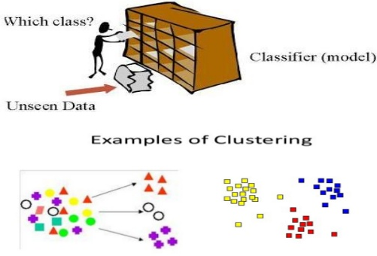
Clustering vs Classification

Slide 15
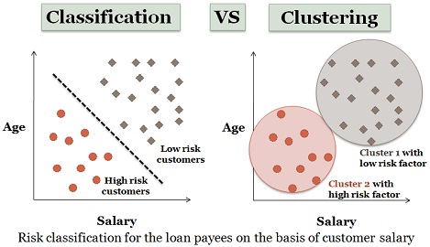
Clustering vs Classification

Slide 16
Thanks

